Slide 1
Computer Application
MS Excel 2016

Slide 2
Microsoft Excel
MS application to create worksheets
Used mainly for accounting and statistics
It features calculation, graphing tools and pivot tables

Slide 3
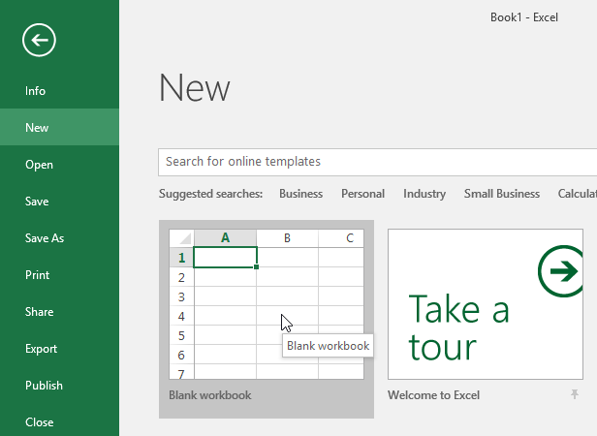
Creating a new workbook

Slide 4
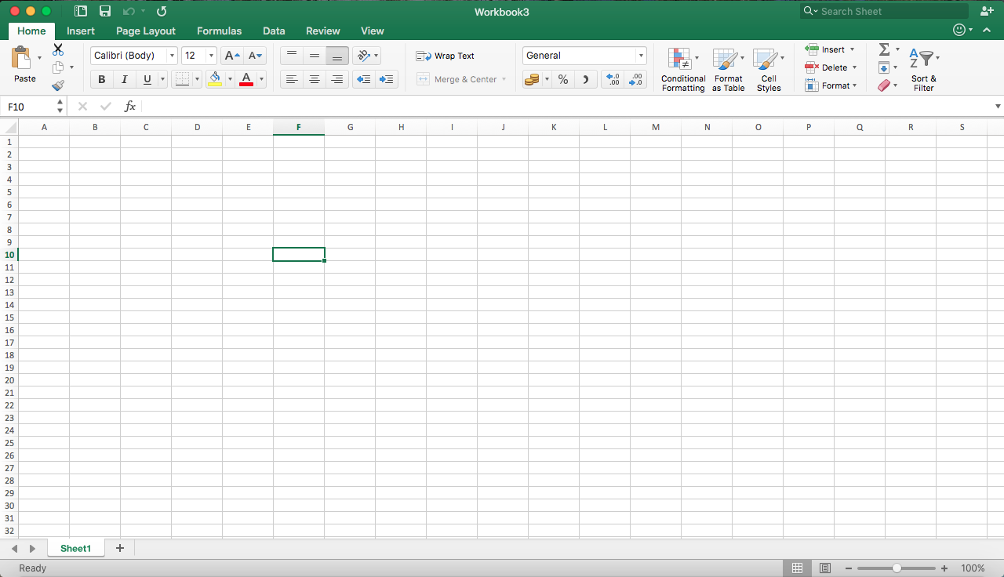
Basics
Cell F10
Formula Bar
The green rectangle shows current cell

Slide 5
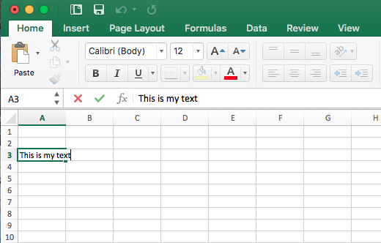
Entering data
The text will appear in two areas:
The actual cell
The Formula bar

Slide 6
Formatting Attributes
Cells can contain formatting attributes that change the way letters, numbers, and dates are displayed. For example, percentages can appear as 0.15 or 15%. You can even change a cell's text or background color.

Slide 7
Range
You can also select multiple cells at the same time. A group of cells is known as a cell range. Rather than a single cell address, you will refer to a cell range using the cell addresses of the first and last cells in the cell range, separated by a colon.

Slide 8
To move around the cells
either: move the mouse over the relevant cell and click the left button
or: use the cursor keys.
To move:
to the last cell in the column press Ctrl ↓
to the first cell in the column press Ctrl ↑
to the last cell in the row press Ctrl →
to the first cell in the row press Ctrl ←

Slide 9
Selection
Cells: Click on the desired cell to select it.
Columns/Rows: Click on the button of the column/Row
Consecutive Cells: Left click on the first cell and drag your mouse. When all the desired cells are selected, release your hold of the mouse.
Consecutive Columns/Rows: Left click on the first button and drag your mouse. When all the desired cells are selected, release your hold of the mouse.
Selecting cells, columns, rows that are apart. (CTRL)

Slide 10
Delete Cell Content
Select the cell(s) with content you want to delete. In our example, we'll select the cell range A10:H10.
Select the Clear command on the Home tab, then click Clear Contents.

Slide 11
Copy and Paste Content
To copy the content of a cell to another cell:
  Press Ctrl + C on your keyboard
  Click on the copy command on the Home tab
To paste the copied content :
  Press Ctrl + V on your keyboard
  Click on the paste command on the Home tab

Slide 12
Special Paste
You can also access additional paste options, which are especially convenient when working with cells that contain formulas or formatting. Just click the drop-down arrow on the Paste command to see these options.

Slide 13
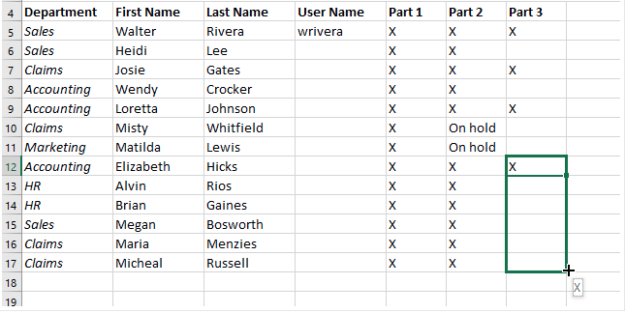
The Fill Handle
If you're copying cell content to adjacent cells in the same row or column, the fill handle is a good alternative to the copy and paste commands.
hover the mouse over the lower-right corner of the cell so the fill handle appears. Drag the fill handle until all of the cells you want to fill are selected

Slide 14
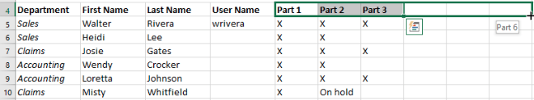
The Fill Handle
The fill handle can also be used to continue a series. Whenever the content of a row or column follows a sequential order, like numbers (1, 2, 3) the fill handle can guess what should come next in the series.
In most cases, you will need to select multiple cells before using the fill handle to help Excel determine the series order.

Slide 15

Sheets
You start with 1 sheet.
The white Tab => Sheet is active
To add sheet, click on the +
To rename a sheet,
  Double click on sheet tab and type the new name.
  Right click, select Rename and type the new name.

Slide 16
Sheets
Moving a sheet: Click on the sheet tab and drag it left or right to the desired position.
To delete a sheet:
  Right click on the tab and select Delete
  Select the sheet tab and press Delete on the keyboard.

Slide 17
Cell Reference
most of the time you will use cell addresses to create a formula. This is known as making a cell reference. Using cell references will ensure that your formulas are always accurate because you can change the value of referenced cells without having to rewrite the formula.
In the formula, cell A3 adds the values of cells A1 and A2 by making cell references

Slide 18
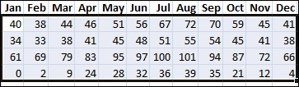
Sorting in Excel
Select the data that you want to sort
Select a range of data, such as A1:L5 (multiple rows and columns) or C1:C80 (a single column). The range can include titles (headers) that you create to identify columns or rows.

Slide 19

Sorting in Excel
Sort quickly
Select a single cell in the column you want to sort.
On the Data tab, in the Sort & Filter group, click to perform an ascending sort (A to Z or smallest number to largest).
Click to perform a descending sort (Z to A or largest number to smallest).

Slide 20

Sorting in Excel
Sort by specifying criteria
Select a single cell anywhere in the range that you want to sort.
On the Data tab, in the Sort & Filter group, click Sort.
3. In the Sort by list, select the first column on which you want to sort.
In the Sort On list, select either Values, Cell Color, Font Color, or Cell Icon
In the Order list, select the order that you want to apply to the sort operation — alphabetically or numerically ascending or descending.

Slide 21
Simple Formulae
By combining a mathematical operator with cell references, you can create a variety of simple formulae in Excel as in the examples below:

Slide 22
Creating a Formula
Select the cell that will contain the formula and type the equals sign (=)
Type or select the cell address of the cell you want to reference first in the formula
Type the mathematical operator you want to use
Type or select the cell address of the cell you want to reference second in the formula
Press Enter on your keyboard. The formula will be calculated, and the value will be displayed in the cell.

Slide 23
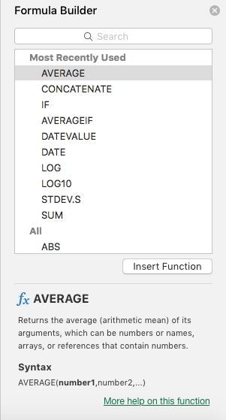
Inserting a Function
Select the cell where you want the answer of the equation to appear.
Click the function icon.
The Insert function box will open.
Select one of the functions that are displayed in the Select a function section and click OK.

Slide 24
Some Common Functions
There are a variety of functions available in Excel. Here are some of the most common functions you'll use:
SUM: This function adds all of the values of the cells in the argument.
AVERAGE: This function determines the average of the values included in the argument. It calculates the sum of the cells and then divides that value by the number of cells in the argument.

Slide 25
Some Common Functions
COUNT: This function counts the number of cells with numerical data in the argument. This function is useful for quickly counting items in a cell range.
MAX: This function determines the highest cell value included in the argument.
MIN: This function determines the lowest cell value included in the argument.

Slide 26
Functions
The available functions
The description of the selected function

Slide 27
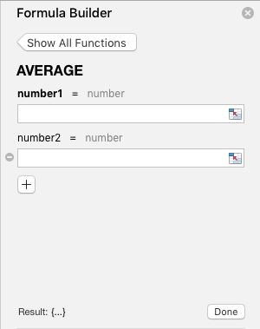
Functions
You can insert the address of the cells that you want to apply the formula on in the field labelled Number 1. Or you can click on the button next to it and select the cells with the mouse.

Slide 28
The IF Function
The IF function is one of the most popular functions in Excel, and it allows you to make logical comparisons between a value and what you expect. In its simplest form, the IF function says:
  IF(Something is True, then do something, otherwise do something else)
So an IF statement can have two results. The first result is if your comparison is True, the second if your comparison is False.

Slide 29
The Nested IF Function
Nesting refers to the practice of joining multiple functions together in one formula.
Example:

Slide 30
Nested IF Function
=IF(D2>89,"A",IF(D2>79,"B",IF(D2>69,"C",IF(D2>59,"D","F"))))
This means:
  If the Test Score (in cell D2) is greater than 89, then the student gets an A
  If the Test Score is greater than 79, then the student gets a B
  If the Test Score is greater than 69, then the student gets a C
  If the Test Score is greater than 59, then the student gets a D
  Otherwise the student gets an F

Slide 31
IFS Function
The IFS function checks whether one or more conditions are met and returns a value that corresponds to the first True condition.
IFS can take the place of multiple nested IF statements, and is much easier to read with multiple conditions.
IFS([Something is True1, Value if True1, [Something is True2, Value if True2],…[Something is True127, Value if True127])

Slide 32
IFS Function
Which says:
IF(A2 is Greater Than 89, then return a "A", IF A2 is Greater Than 79, then return a "B", and so on and for all other values less than 59, return an "F").
Example:
The formula for cells A2:A6 is:
=IFS(A2>89,"A",A2>79,"B",A2>69,"C",A2>59,"D",TRUE,"F")

Slide 33
Charts
In Excel 2016, charts and diagrams can show trends, averages, high and low points, and more. Not only do they make your worksheets more visually appealing, they also make it easier for your intended audience to sort out and understand information.
There are many different kinds of charts available in MS Excel--pie charts, bar charts, line charts, even organizational charts.

Slide 34
Pie Chart
Data that's arranged in one column or row on a worksheet can be plotted in a pie chart.
Pie charts show the size of items in one data series, proportional to the sum of the items. The data points in a pie chart are shown as a percentage of the whole pie.
Consider using a pie chart when:
You have only one data series.
None of the values in your data are negative.
Almost none of the values in your data are zero values.
You have no more than seven categories, all of which represent parts of the whole pie.

Slide 35
Bar Chart
Data that's arranged in columns or rows on a worksheet can be plotted in a bar chart.
Bar charts illustrate comparisons among individual items. In a bar chart, the categories are typically organized along the vertical axis, and the values along the horizontal axis.
Consider using a bar chart when:
The axis labels are long.
The values that are shown are durations.

Slide 36
Line Chart
In a line chart, category data is distributed evenly along the horizontal axis, and all value data is distributed evenly along the vertical axis.
Line charts can show continuous data over time on an evenly scaled axis, so they're ideal for showing trends in data at equal intervals, like months, quarters, or fiscal years.

Slide 37
Types of Line Charts
Line and line with markers Shown with or without markers to indicate individual data values, line charts can show trends over time or evenly spaced categories.
Stacked line and stacked line with markers Shown with or without markers to indicate individual data values, stacked line charts can show the trend of the contribution of each value over time or evenly spaced categories.

Slide 38
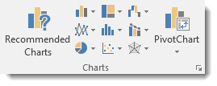
Chart Recommendations
Excel 2016 offers you Recommended Charts tool. This is under the Insert tab on the Ribbon in the Charts group (as pictured below).

Slide 39
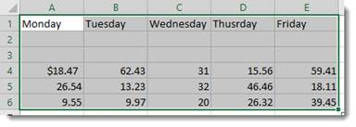
Chart Recommendations
To create a chart this way, first select the data that you want to put into a chart. Include labels and data.

Slide 40
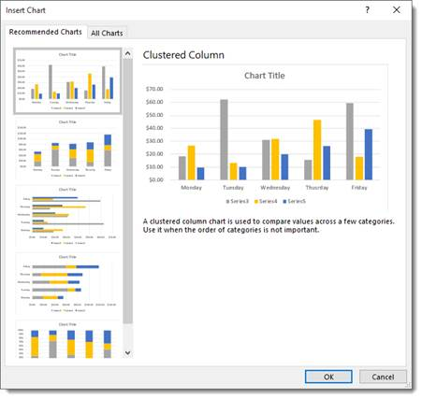
Chart Recommendations
When you click on the Recommended Charts button, a dialogue box opens like the one pictured below.
Based on your data, Excel recommends a chart for you to use.
Choose the chart that you want to use, then click OK.
The chart is embedded in your worksheet for you.

